Slide 1
Using interpolating polynomials

Slide 2
Introduction
In this topic, we will
Describe the assumptions that will be made in the next three sub-topics
Explain how we are assuming negligible error
Look at what information we are trying to extract from these readings

Slide 3
Representing a polynomial
Recall that we have pointed out that sensors are generally sampled periodically
The next three topics will attempt to:
Evaluate an interpolating polynomial at a point close to x_{k}
Estimate the derivative at the point x_{k}
Estimate an integral from some point x_{k – n} up to x_{k}
We will assume negligible error in the readings or values of f (x_{k})
f (x_{k+2})
f (x_{k+1})
f (x_{k})
f (x_{k–2})
f (x_{k–1})
x_{k–2}
x_{k–1}
x_{k}
x_{k+1}
x_{k}
x_{k+2}

Slide 4
Representing a polynomial
In each case, we will assume that the x_{k} values are equally spaced, so in general
x_{k} = x₀ + kh
Also, it follows, therefore, that:
x_{k – 1} = x_{k} – h
x_{k + 1} = x_{k} + h
f (x_{k+2})
f (x_{k+1})
f (x_{k})
f (x_{k–2})
f (x_{k–1})
x_{k–2}
x_{k–1}
x_{k}
x_{k+1}
x_{k}
x_{k+2}

Slide 5
Looking ahead
Once we have examined these approaches, we will proceed to look at techniques that can be used when there are significant errors in the readings
These errors may be due to difficulty in making readings or limitations on the sensors in question
For example, GPS is only so accurate to approximately 4 m

Slide 6
Summary
Following this topic, you now
Understand that in the next three sub-topics, we will use interpolating polynomials
Understand that the errors in the sampled values are assumed to be negligible
Know that in the following topic, we will look at solutions that don’t necessarily assume negligible error

Slide 7
References
[1] https://en.wikipedia.org/wiki/Polynomial_interpolation

Slide 8
Acknowledgments
None so far.

Slide 9
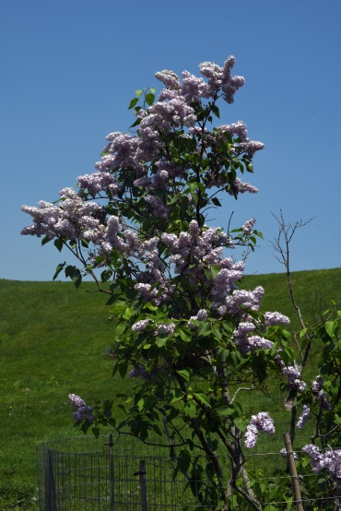
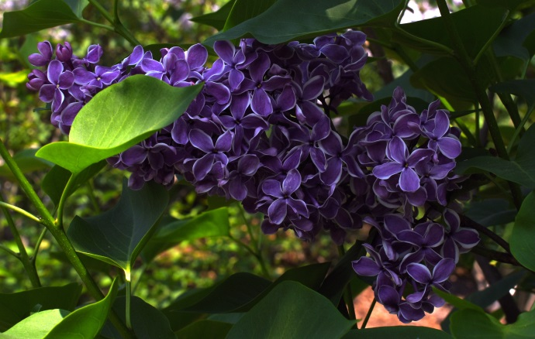
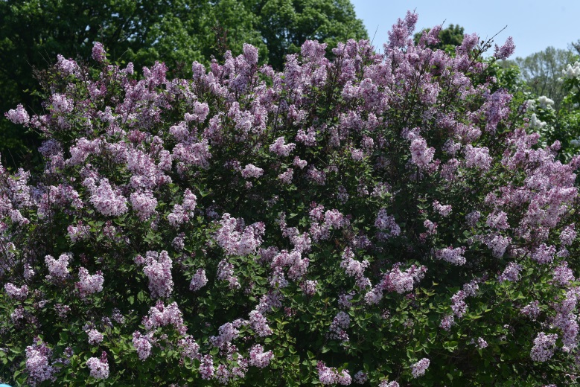
Colophon
These slides were prepared using the Cambria typeface. Mathematical equations use Times New Roman, and source code is presented using Consolas. Mathematical equations are prepared in MathType by Design Science, Inc.
Examples may be formulated and checked using Maple by Maplesoft, Inc.
The photographs of flowers and a monarch butter appearing on the title slide and accenting the top of each other slide were taken at the Royal Botanical Gardens in October of 2017 by Douglas Wilhelm Harder. Please see
https://www.rbg.ca/
for more information.

Slide 10
Disclaimer
These slides are provided for the ece 204 Numerical methods course taught at the University of Waterloo. The material in it reflects the author’s best judgment in light of the information available to them at the time of preparation. Any reliance on these course slides by any party for any other purpose are the responsibility of such parties. The authors accept no responsibility for damages, if any, suffered by any party as a result of decisions made or actions based on these course slides for any other purpose than that for which it was intended.

